Slide 1


Automated Troubleshooting for SDN Control Software
Colin Scott, Andreas Wundsam, Andrew Or, Sam Whitlock, Eugene Huang, Kyriakos Zarifis, Scott Shenker
Notes:
Quick intro to SDN: this is a tech talk tomorrow at a startup that’s going to be adopting our system. They’re actually building production controllers, so the expectation is that they know this stuff. To anyone here who doesn’t know it: 15 second intro to SDN.
You’re welcome to interrupt me throughout

Slide 2
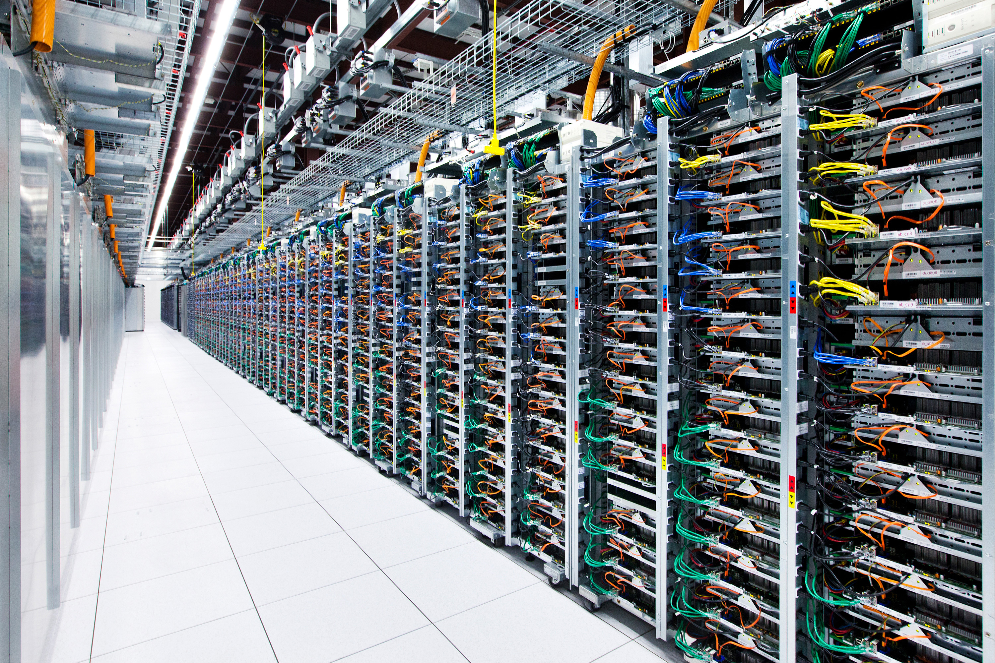

Slide 3

What inputs do SDN controllers see?
20,000 servers * 4 VMs / server = 80,000 VMs
(6 migrations / day / VM) +
(2 power up|down / day / VM) *
80,000 VMs = 640,000 VM events / day
~= 450 VM changes / minute [1]
8.5 network error events / minute [2]
1 policy change / tenant / day *
2000 tenants ~= 1 policy change / minute

Slide 4
What inputs do SDN controllers see?
= ~500 inputs / minute

Slide 5

Something goes wrong!
Notes:
Describe what kinds of bugs these might be: loop, blackhole, breach of tenant isolation.

Slide 6
Triage
Problem in policy? Change it
Problem in network hardware? Call up vendor
Else: problem in control software

Slide 7
Best practice: Logs
Manual analysis of log files

Slide 8
Best practice: Logs
?
Controller A
Switch 1
Switch 2
Switch3
Controller B
Switch 4
Switch 5
Switch 6
Controller C
Switch 7
Switch 8
Switch 9

Slide 9
Goal
Identify a minimal sequence of inputs that triggers the bug

Slide 10
Minimal Causal Sequence

Slide 11
Minimal Causal Sequence
Crash
Master
Ping
Pong
Ping
Backup
Master
Notify
Notify
ACK
Blackhole persists!
Switch
Link Failure
Notes:
Is Rob Vaterlaus in the room?

Slide 12
Minimal Causal Sequence
Master
Ping
Pong
Backup
New Routing Table!
Link Down!
Blackhole resolved!
Switch
Link Failure

Slide 13
Minimal Causal Sequence
Master
Crash
Ping
Pong
Ping
…
Backup
Master
Blackhole avoided!
Switch

Slide 14
Minimal Causal Sequence
Both are necessary conditions!
Master
Crash
Ping
Pong
Ping
Backup
Master
Notify
Notify
ACK
Blackhole persists!
Switch
Link Failure

Slide 15
Minimal Causal Sequence
?
Controller A
Switch 1
Switch 2
Switch3
Controller B
Switch 4
Switch 5
Switch 6
Controller C
Switch 7
Switch 8
Switch 9
Notes:
OK, so how are we going to get from here…

Slide 16
Approach: Simulated Execution
Notes:
Need a way to replay a system execution.
Two use cases for this: in our evaluation we actually used this simulator to drive testing. Randomly generate input traces, detect bugs using Peyman’s HSA tool, then minimize the traces.

Slide 17
Workflow

Slide 18
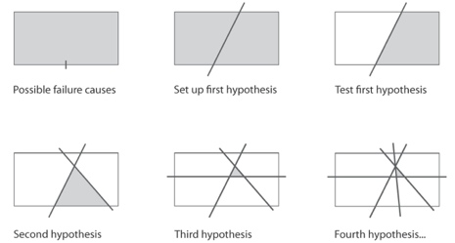
Approach: Delta Debugging
Modify history!
Notes:
If any of you are aware of the work, this technique is called delta debugging.
We let headerspace analysis do the bug detection for us: loops, blackholes, etc.
I should emphasize that, other than discovering this literature, this is not the contribution of this work. Instead, its.. Next slide.
Right now the cuts we make are based on time. But you could imagine doing this slicing based on nodes in the topology, or combinations of types of events.

Slide 19
Replaying Pruned Inputs is Hard
Must consider internal events
Crash
Master
Ping
Seq=3
Pong
Seq=4
Ping
Seq=5
Timeout
Backup
Master
port_status
Xid=12
port_status
xid=13
ACK
Blackhole persists!
Switch
Link Failure
Timeout

Slide 20
Replaying Pruned Inputs is Hard
Must consider internal events
Crash
Master
Ping
Seq=3
Pong
Seq=4
Ping
Seq=5
Timeout
Backup
New Routing Table!
Master
port_status
Xid=12
Blackhole resolved!
Switch
Link Failure

Slide 21

Pruning Alters Internal Events!

Slide 22
Pruning Alters Internal Events!
Prune Earlier Input..
Crash
Master
Ping
Seq=3
Pong
Seq=4
Ping
Seq=5
Timeout
Backup
Master
port_status
xid=12
port_status
xid=13
ACK
Blackhole persists!
Switch
Link Failure
Timeout

Slide 23
Pruning Alters Internal Events!
Sequence Numbers Differ!
Crash
Master
Ping
Seq=2
Pong
Seq=3
Ping
Seq=4
Timeout
Backup
Master
port_status
xid=11
port_status
xid=12
ACK
Blackhole persists!
Switch
Link Failure
Timeout

Slide 24
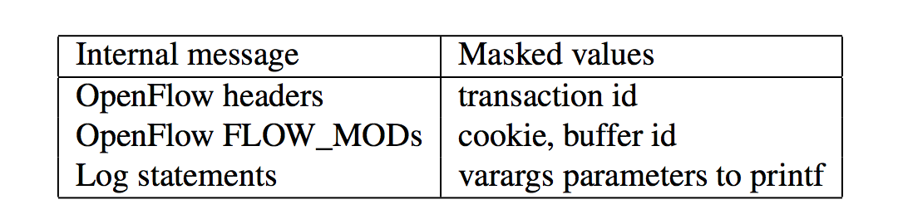
Solution: Equivalence Classes
Mask Over Extraneous Fields

Slide 25
Other Subtleties: Old/New Events
Pruning inputs may also cause:
Expected internal events to disappear
New internal events to appear
See our paper for more info: eecs.berkeley.edu/~rcs/research/sts.pdf

Slide 26
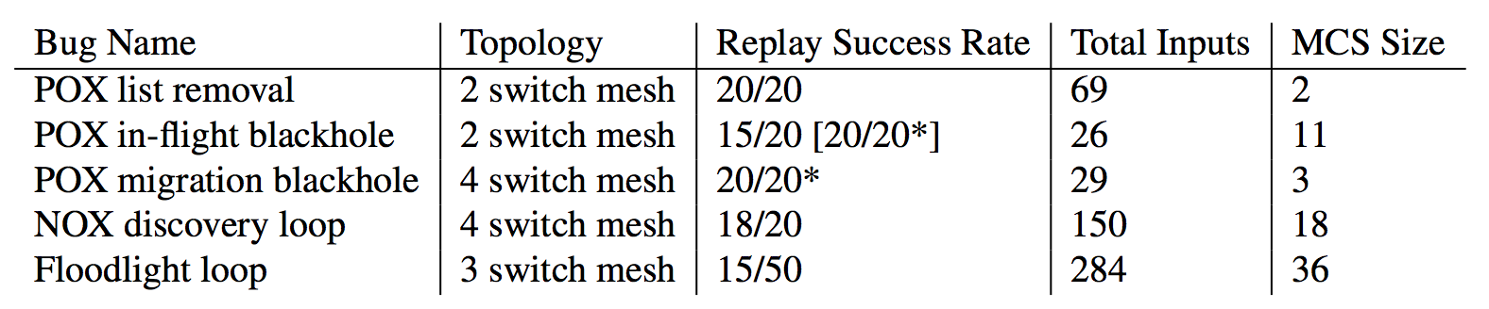
It Works!

Slide 27
It Works!

Slide 28
Demo
sts demo

Slide 29
Summary
Goal: automatically diagnose network problems
Approach: iteratively alter history
Check us out:
ucb-sts.github.com/sts/

Slide 30
References
[1] V. Soundararajan and K. Govil. Challenges in building scalable virtualized datacenter management. SIGOPS Operating Systems Review ’10.
[2] A. Greenberg, J. R. Hamilton, N. Jain, S. Kandula, C. Kim, P. Lahiri, D. A. Maltz, P. Patel, and S. Sengupta. VL2: a scalable and flexible data center network, Sec. 3.4. SIGCOMM ’09.

Slide 31
Backup

Slide 32
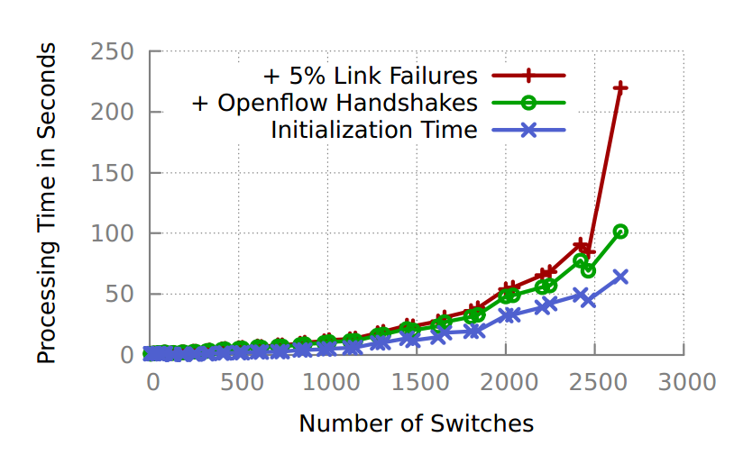
Scalability

Slide 33
Complexity
Best Case | Worst Case
Delta Debugging: O(log n) replays Each replay: O(n) events Total: O(nlog n) | Delta Debugging: O(n) replays Each replay: O(n) events Total: O(n²)
Notes:
Key issue is not complexity, it’s running in parallel overnight. Reduce dev time at all costs!
Optimizations:
- can be parallelized
Can take periodic snapshots
Causal annotations

Slide 34
Opportunity: Parallelization
Could run delta-debugging speculatively:
Each replay runs as a separate task
Join results at the end
Decreases overall runtime by up to a factor of N

Slide 35
Coping With Non-Determinism
Replay multiple times per subsequence
Probability of not finding bug defined by Bernoulli Distribution:
Notes:
Hint: this is very small
Other tricks:
- multiplexed sockets
- override gettimeofday and rand
- interpose on logging library
- interpose on intra-controller messages

Slide 36
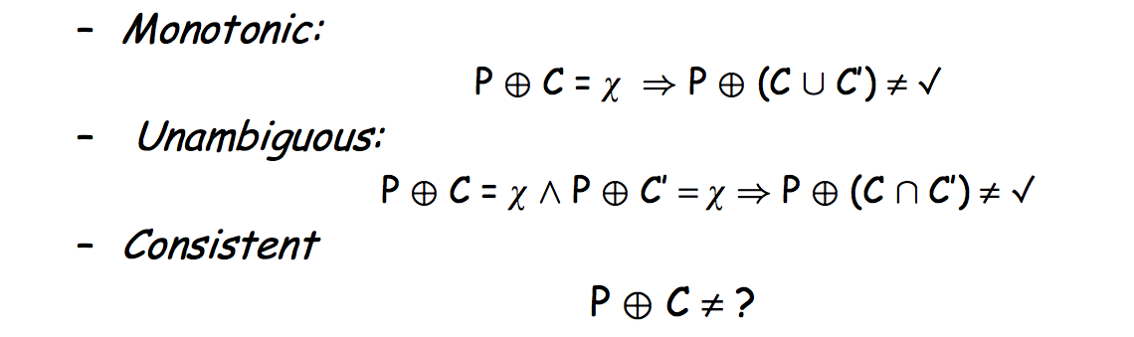
Assumptions of Delta Debugging

Slide 37
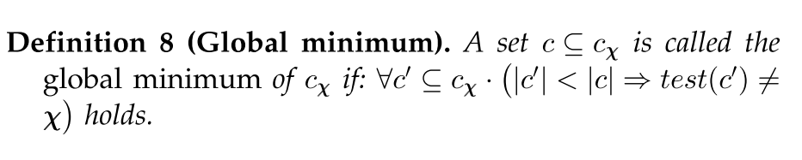
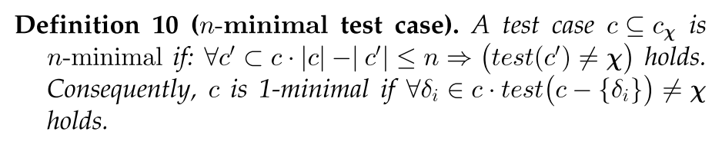
Local vs. Global Minimality

Slide 38
Limited Internal Event Visibility
Interpose on logging library to gain visibility into internal state changes
Still, may not obtain visibility into all relevant events!
Extreme case: need visibility into thread scheduling decisions.

Slide 39
Forensic Analysis of Production Logs
Logs need to capture causality: Lamport Clocks or accurate NTP
Need clear mapping between input/internal events and simulated events
Must remove redundantly logged events
Might employ causally consistent snapshots to cope with length of logs

Slide 40
Related Work
Delta Debugging, Sherlog, Rx, Chronus
OFRewind, ndb
Pip, X-trace
Mininet, ns-3
Model checkers: NICE, Mace
Root cause analysis

Slide 41
Future Work
Many improvements:
Parallelize delta debugging
Smarter delta debugging time splits
Split by topology (actors) rather than time
Split by event type
Compress time (override gettimeofday)
Apply to other distributed systems

